Slide 1

Task schedular using c++
By- Anshu Hada
Section- A

Slide 2
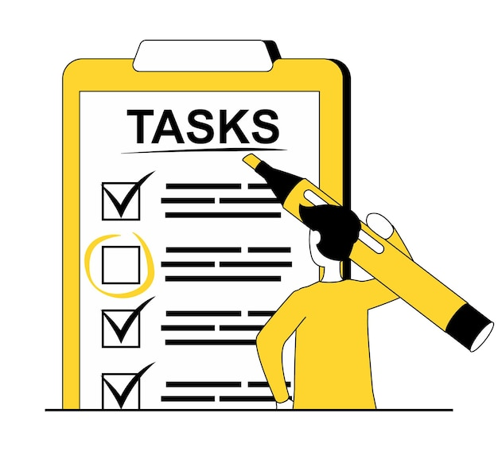
Introduction:
A Task Scheduler is a tool designed to help people organize, manage, and prioritize tasks.
Task Scheduler provides a useful way to manage multiple tasks based on priority and deadlines
It allows users to keep track of their progress, mark tasks as completed, and receive reminders for incomplete tasks. This helps users stay organized and meet their deadlines on time.

Slide 3

Objective
The main objective of this project is to helps users effectively manage tasks based on their priorities and deadlines.
The key goals are:
Task Management: Provide an easy way to add, update, delete, and search for tasks.
Priority Handling: Ensure that tasks with higher priority are handled first.
Deadline Tracking: Track deadlines and ensure timely completion.
Progress Monitoring: Evaluate the weekly progress of task completion.
Reminders: Provide reminders for tasks that are not completed.

Slide 4
Key functionalities
The Task Scheduler has the following key functionalities to help users efficiently manage their tasks:
Add Task
View Tasks
Search Task
Delete Task
Mark Task as Completed
Track Weekly Progress
Reminders for Pending Tasks

Slide 5
Tools and resources
IDE (Integrated Development Environment): This project used Dev-C++ IDE to write, edit, and debug code.
Libraries: This application used libraries such as the Standard C++ Library like iostream, string, iomanip, and c time for input/output, string manipulation, formatting, and retrieve the current date and time.
Data Structures:
It uses a priority queue (implemented with a heap) to manage tasks based on priority, ensuring high priority tasks are handled first.
Dynamic arrays store tasks, allowing for flexible memory management as the number of tasks grows.
Structures are used to organize and store task details like name, description, priority and deadline.

Slide 6

Conclusion
The Task Scheduler helps to track of progress, mark tasks as completed, and receive reminders for incomplete tasks.
This helps users stay organized and meet their deadlines on time.
Tasks are automatically sorted by priority using a priority queue, ensuring that tasks with higher priority are handled first.

Slide 7
Thank you!!

